Slide 1


Global AI Innovation Challenges

Slide 2
Contest Theme & Background
This event aims to attract environmentally-conscious technical experts from across the globe and increase the public attention to and participation in environmental protection by gauging the influence of weather changes on people’s lives. Contestants can compare and analyze weather data from different sources to explore the social value of intelligent weather forecasting applications. In addition, they can leverage Alibaba Cloud’s computing capabilities and visualization tools to present their innovative weather forecasting solutions to the judges and the public.
Contestants can develop their innovative solutions by using open-source meteorological data from different platforms, including but not limited to historical weather data, air quality monitoring data, meteorological monitoring data (wind, temperature, rainfall, etc.), and transport data.
Contestants are encouraged to consider a wide range of weather-related solutions. They can choose any weather-related fields, including but not limited to the impact of weather pattern changes on urban traffic, air quality, airdrome control and harbor control, crops, revenues of supermarkets and restaurants, and theater ticketing.

Slide 3
Table of Contents
01
03
05
02
04
06
Project Introduction
Commercial Value
The Team
Problem Statement & Solution or advantages (demo is permitted)
What market value and profit model will created, development process etc
Team members & background
Technology Adoption
Specific Requirements
Declaration of Originality
Technology Architecture, Data Set, Algorithm, method & tools etc
How to Apply the technology & the advantages
Committed with your ideas originality

Slide 4
01
Project Introduction

Slide 5
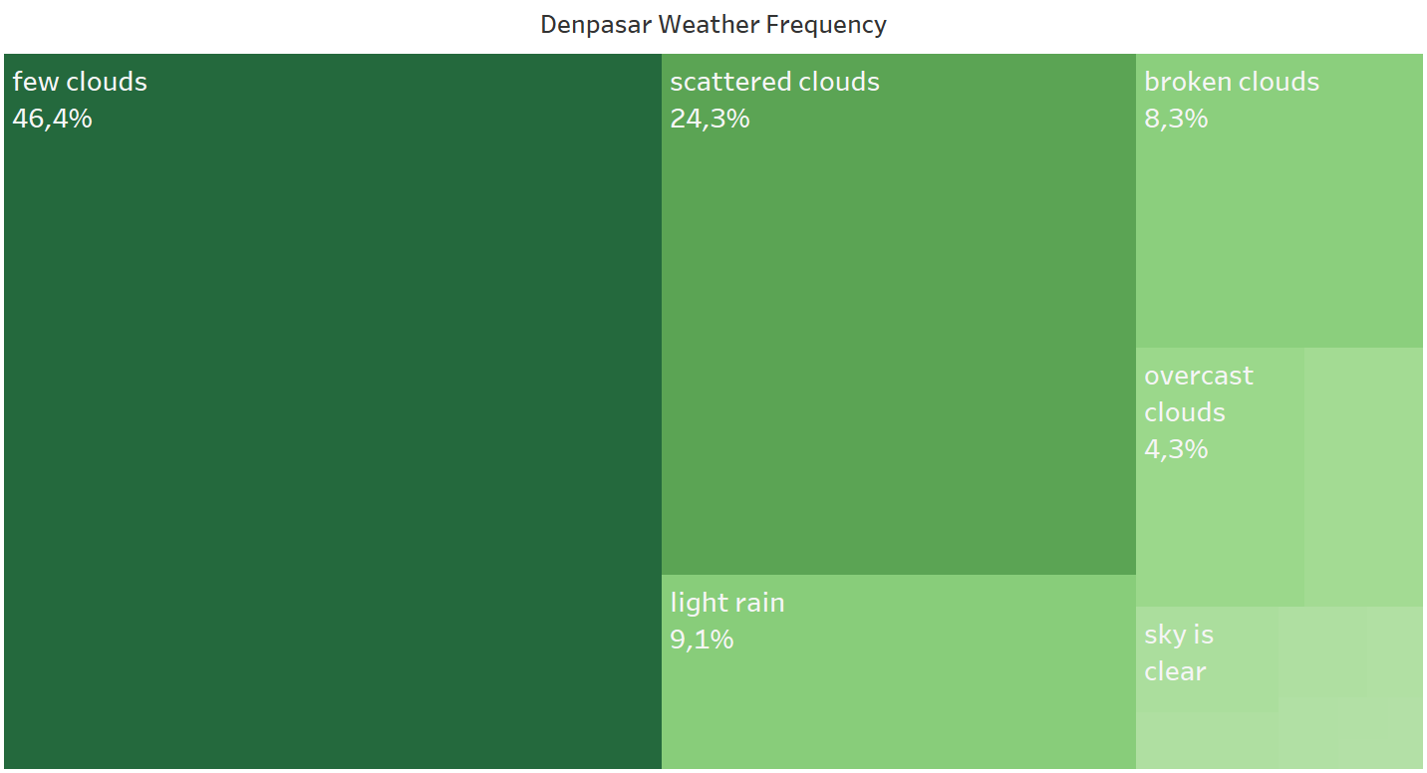
Problem Statement
Denpasar weather mostly is cloudy (70%) from the past 30 years, how we can apply this fact into a business?

Slide 6
Solutions
We will see, is next September 2021 is going to be cloudy day in Denpasar? I will make forecasting, you will see in the next slide ->

Slide 7
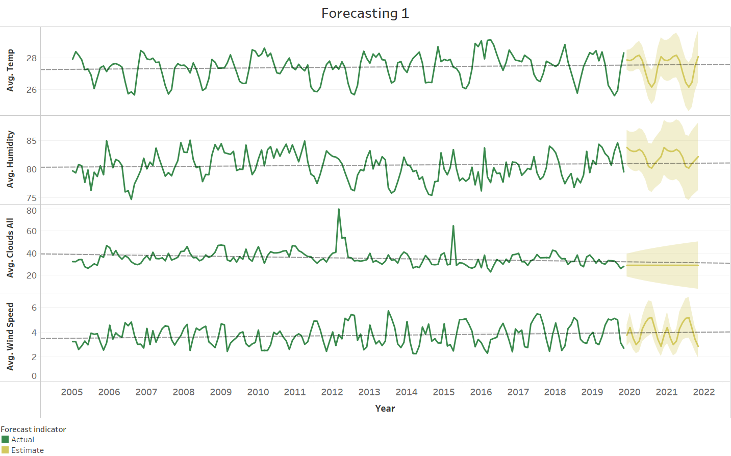
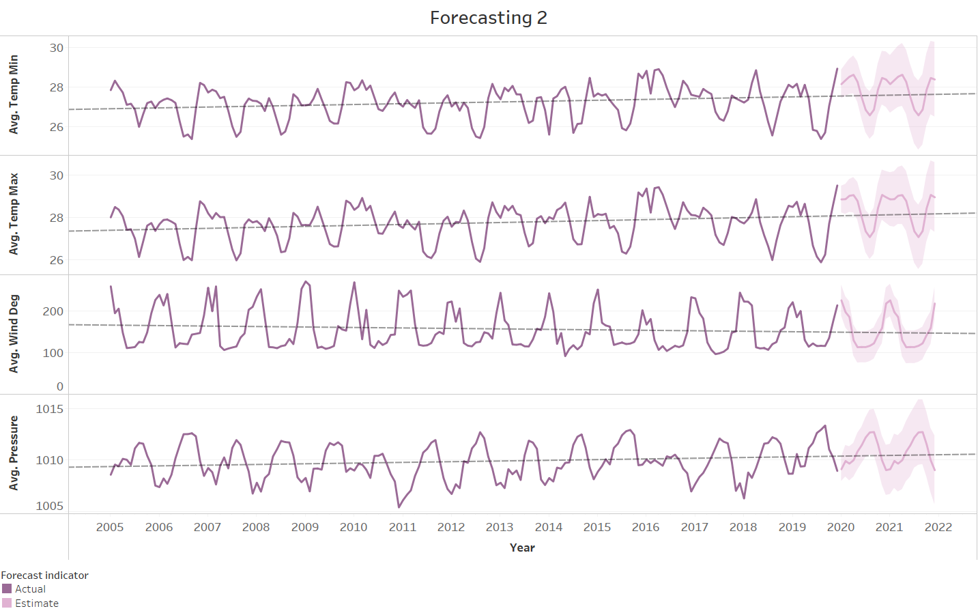
Sneak Peek
Given the data from 2005 until late 2019, I made forecasting for all feature that needed for predicting weather

Slide 8
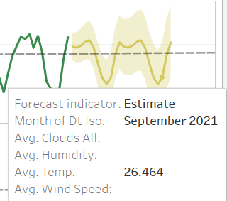
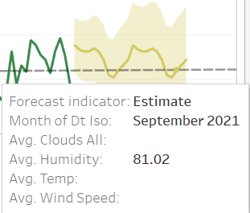
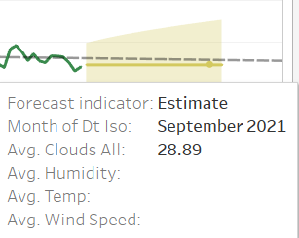
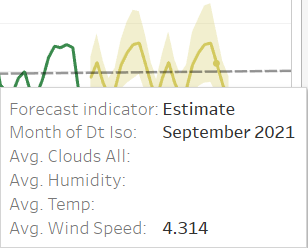
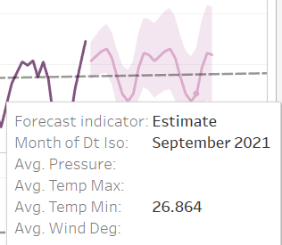
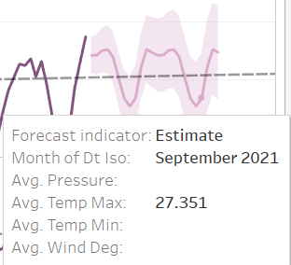
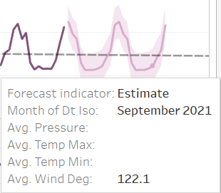
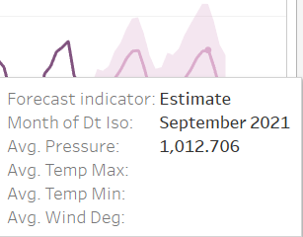
Sneak Peek
I will make prediction, which weather might be happen in September 2021 at Denpasar using the feature from forecasting data such as Temp, Humidity, etc

Slide 9
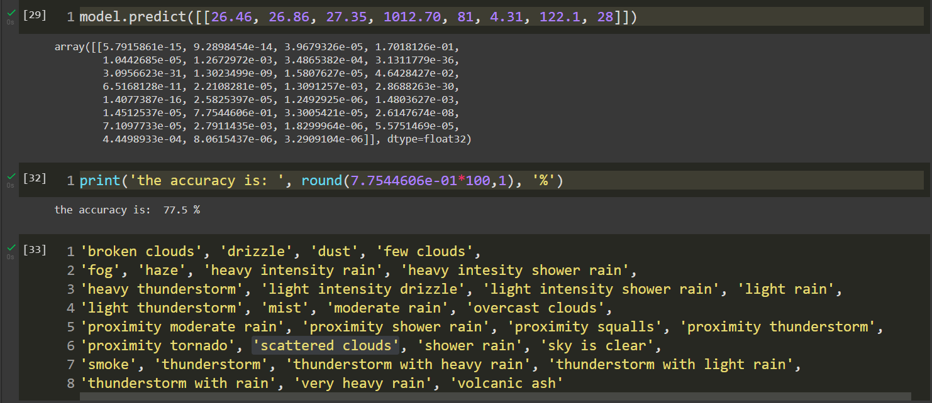
Sneak Peek
Next after I made the model and fit it, I predict the feature from forecasting data and the result is Denpasar at September 2021 will be dominated by Scattered Cloudy Day

Slide 10
02
Technology Adoption

Slide 11



Technology Architecture & Data
Google Colab
Tableau
Dataset
openweatherdata-denpasar-1990-2020.csv
Using Python & Libraries (Keras, Tensorflow, Sklearn, etc) to build Deep Leaning Algorithm
Visualization Data and Make Forecast for Temperature, Wind Speed, Humidity also Cloudy Value
Link
Link
Link
Technology Architecture, Data Set, Algorithm, method & tools etc

Slide 12
03
Commercial Value

Slide 13
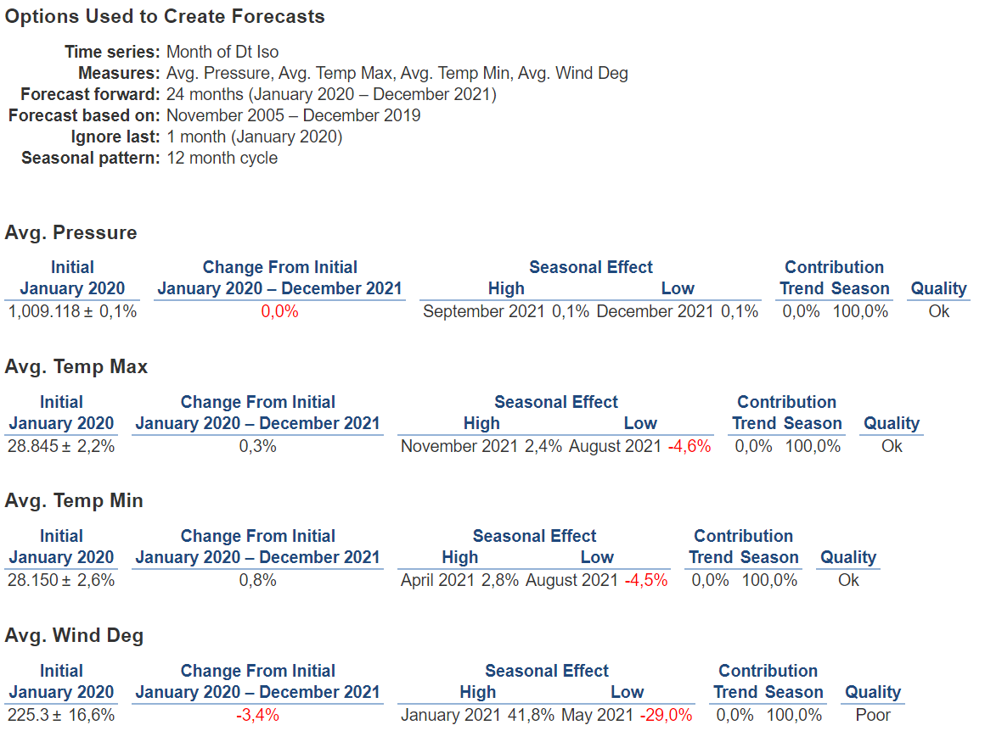
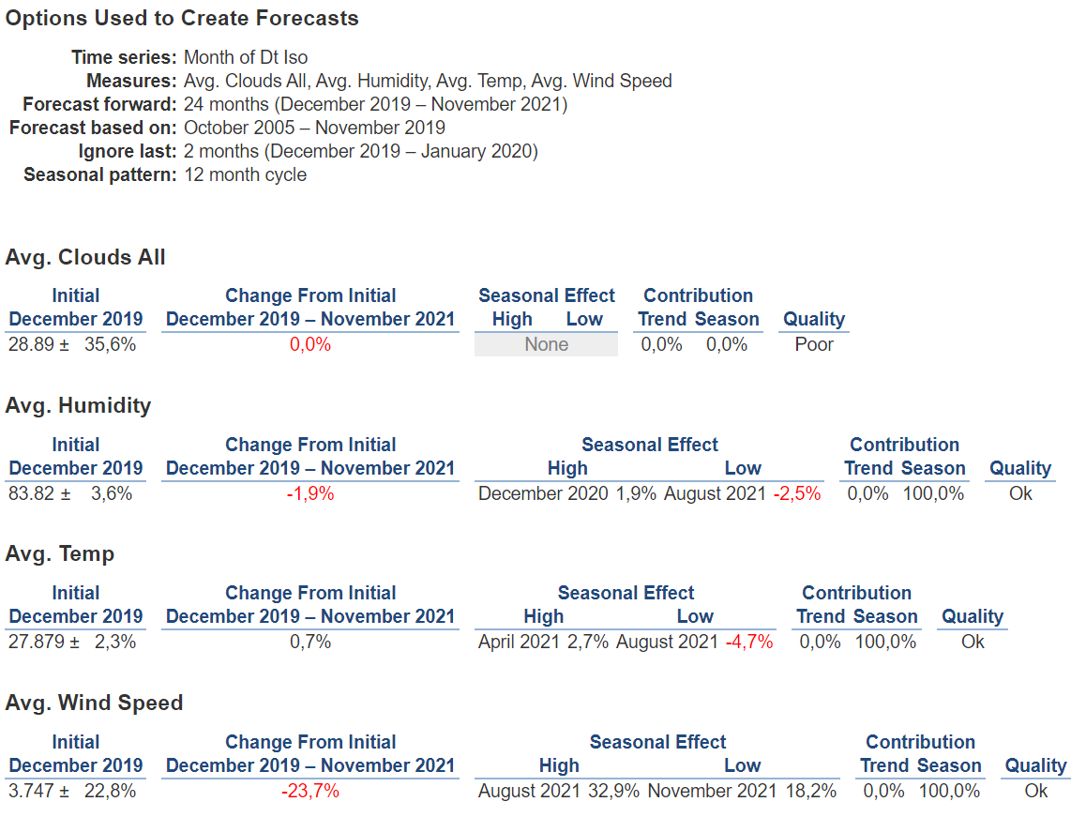
The Business Model Canvas
Key Values
Wind speed will continue going lower starting from August – November 2021 so the activity such as paragliding is not the chosen one for business
In contrast the Temperature and Humidity is going higher starting from August 2021 so people might stay at hotel and minimizing the activity at outdoor

Slide 14
04
Specific Requirements

Slide 15
Specific Requirements
Simple Algorithm, Huge Impact for Thinking
I’m starting to make really fast forecasting in Tableau, such a great software. After i got the insight from the forecasting data, next i make simple classification algorithm using simple Artificial Neural Network, but before that i want to make multivariate time series using LSTM but the result is quite bad and really hard to make visualization. So the company should see that complex algorithm not always good thing, choose the simple one might be better for productivity.

Slide 16
05
The Team

Slide 17
Our Team
Ade Irman
Freshman in Bandung Institute of Technology
Email: adeirman2705@gmail.com
Instagram:
Adeirman2705

Slide 18
06
Declaration of Originality

Slide 19
“
We hereby declare that this submission is our own work and to the best of our knowledge it contains no materials previously published or written by another person, or substantial proportions of material which have been accepted for the award of any other degree or diploma at any other institution, except where due acknowledgement is made in the proposal Any contribution made to the research by others, with whom we have worked or elsewhere, is explicitly acknowledged in the thesis. I also declare that the intellectual content of this proposal is the product of our own work, except to the extent that assistance from others in the project's design and conception or in style, presentation and linguistic expression is acknowledged.’
”
—Ade Irman

